Slide 1
THYROID DISEASE CLASSIFIER
Using Two-Tier Ensemble Methods
221710310021 G. Sai Naga Rahul
221710310026 K. Anirudha Raghava Sarma
221710310002 Alluri Nikhil Yadav
221710310059 Rohith Reddy Ganga
Mrs. G. Hima Bindu (Project Guide)

Slide 2
ABSTRACT
Nowadays hormone disturbance is an essential issue in humans. The fundamental issue that troubles behind thyroid diseases is hormonal disturbance. Thyroid disease is the severe endocrine disease that adversely affects the wellbeing of the human. In such case, disease prediction model can play an important role in disease prognosis.
The work deploys wrapper method for feature selection. We have identified top machine learning algorithms for thyroid prediction and these five classifiers are consolidated in the gathering of three with heterogeneous permutations to further improve the performance of deployed classifiers. Majority voting scheme is deployed on the ensemble methods for getting results. The proposed model utilizes 70:30 proportions of training and test set. The outcome uncovered that the accuracy of proposed 2-tier ensemble model is increased as compared with single machine learning classifiers.

Slide 3
WHY THIS PROJECT?
In today’s world, the thyroid disease is widely spread and it causes harsh damage to the human body and life. It damages the normal functioning of thyroid gland.
Presently in excess of 25,000 emergency clinics over the globe gather information on patients in different configuration. In the conventional technique, the clinical and medical studies are accomplished utilizing traditional examination and measurable tests.
The avoidance of this sickness requires fundamental information on the event of this illness as it is very complicated to fix this malady once it arrives at its last stages.

Slide 4
PROPOSED SYSTEM
A novel blend of the best machine learning models are utilized to build up a ensemble model for deciding the presence of thyroid in the thyroidal patient. The system creates the proposed model in two stages-
1st stage- Six distinct models are trained with 70% dataset and 30% dataset for thyroid disease diagnosis. (Tier 1 models).
2nd Stage - Top models are consolidated and ensembled, making unique combinations to possibly further improve the performance of thyroid prediction model (Tier 2 models).

Slide 5
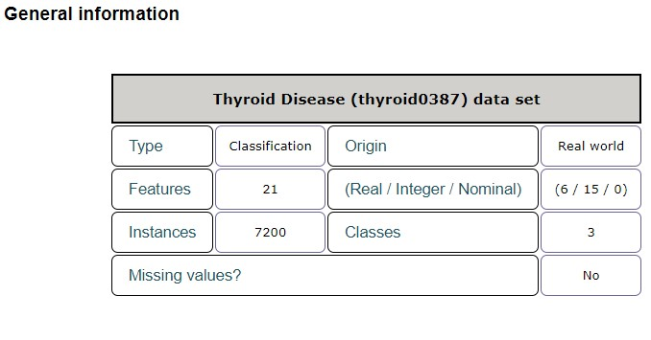
DATASET
The Thyroid disease data set is available at the UCI repository.
The task is to detect is a given patient is:
(1) normal, or suffers from
(2) hyperthyroidism or
(3) hypothyroidism

Slide 6
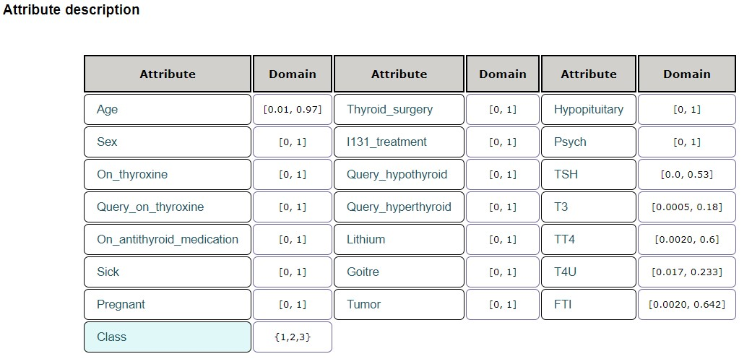

Slide 7
Requirements
Software:
Python 3.7
Jupyter Notebook
Anaconda Navigator
Microsoft excel
Hardware:
OS: Macine with Windows/ Linux
Processor: Intel i3 or better
RAM: minimum 4gb
HDD: 256GB
Packages:
Scikit-learn, pandas
matplotlib, seaborn

Slide 8
WORK-FLOW
Importing essential packages
Splitting of dataset (70% training data, 30% test data)
Selection of classification algorithms from scikit-learn. They are:
Logistic Regression, SVM, K-Nearest Neighbours, Naive Bayes, Decision-Trees, Random Forest
Ensemble of best algorithms
Selection of best ensemble model based on accuracy achieved

Slide 9
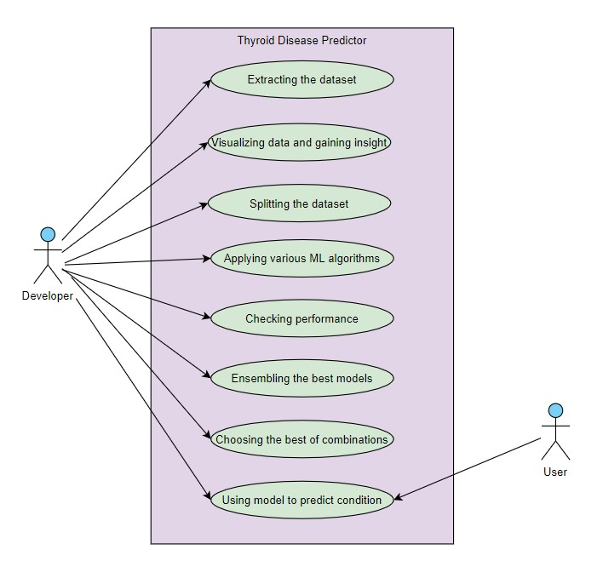
Use-Case Diagram

Slide 10
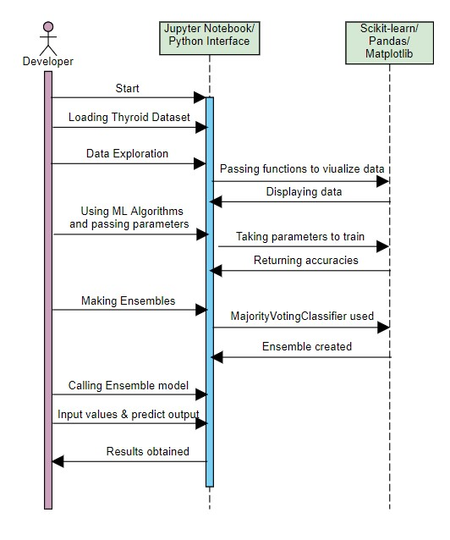
Sequence Diagram

Slide 11
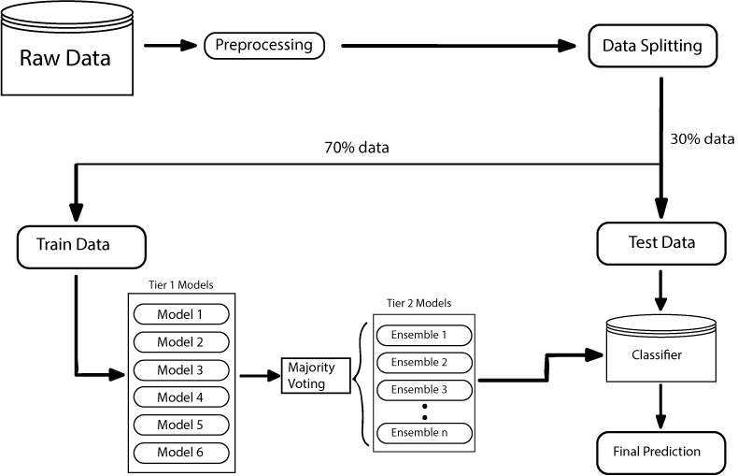
FLOWCHART
Best ensemble based on accuracy
input data

Slide 12
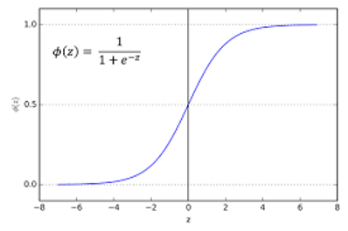
Logistic Regression
Due to the nature of probability, the prediction will fall in [0, 1]. Decisions are made based on whether the probability is greater than or less than 0.5
However, the range of linear regression is from negative infinite to positive infinite, not in [0, 1]. Thus, sigmoid function is introduced to solve this problem.
Multiclass classification with logistic regression can be done either through the one-vs-rest scheme in which for each class a binary classification problem of data belonging or not to that class is done

Slide 13
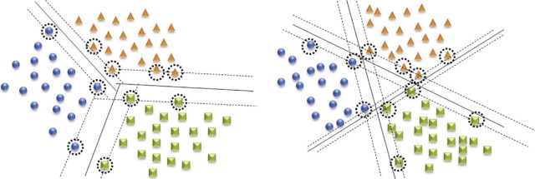
Support Vector Machines
In its most simple type SVM are applied on binary classification, dividing data points either in 1 or 0.
For multiclass classification, the same principle is utilized. The multiclass problem is broken down to multiple binary classification cases, which is also called one-vs-one.
In the one-vs-one approach, each classifier separates points of two different classes and comprising all one-vs-one classifiers leads to a multiclass classifier.

Slide 14
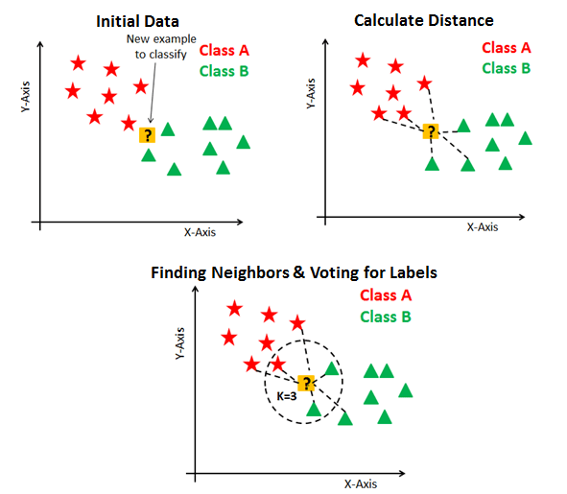
K Nearest Neighbors
KNN or k-nearest neighbours is the simplest classification algorithm. This classification algorithm does not depend on the structure of the data.
Whenever a new example is encountered, its k nearest neighbours from the training data are examined. Distance between two examples can be the euclidean distance between their feature vectors.
The majority class among the k nearest neighbours is taken to be the class for the encountered example.

Slide 15
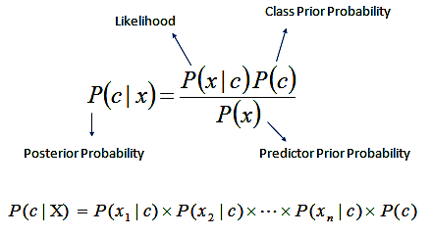
Naive Bayes Algorithm
The algorithm used in the project is the Multinomial Naive Bayes Classifier
Naive Bayes classification method is based on Bayes’ theorem. It is termed as ‘Naive’ because it assumes independence between every pair of feature in the data.
Multinomial Naive Bayes consider a feature vector where a given term represents the number of times it appears or very often i.e. frequency.

Slide 16
Decision Tree Algorithm
Decision tree classifier is a systematic approach for multiclass classification.
It poses a set of questions to the dataset (related to its attributes/features).
The decision tree classification algorithm can be visualized on a binary tree. On the root and each of the internal nodes, a question is posed and the data on that node is further split into separate records that have different characteristics.
The leaves of the tree refer to the classes in which the dataset is split.
We perform breaking down the data by making decisions based on multiple questions at each level.

Slide 17
Random Forest
A forest is comprised of trees. It is said that the more trees it has, the more robust a forest is.
Random forests creates decision trees on randomly selected data samples, gets prediction from each tree and selects the best solution by means of voting.
It also provides a pretty good indicator of the feature importance.
Random forest uses gini importance or mean decrease in impurity (MDI) to calculate the importance of each feature. Gini importance is also known as the total decrease in node impurity. This is how much the model fit or accuracy decreases when you drop a variable. The larger the decrease, the more significant the variable is.
Deep decision trees may suffer from overfitting, but random forests prevents overfitting by creating trees on random subsets.

Slide 18
AdaBoost Classifier
The core principle of AdaBoost is to fit a sequence of weak learners on repeatedly modified versions of the data.
The predictions from all of them are then combined through a weighted majority vote (or sum) to produce the final prediction.
The first step is to simply train a weak learner on the original data. For each successive iteration, the sample weights are individually modified and the learning algorithm is reapplied to the reweighted data.
As iterations proceed, examples that are difficult to predict receive ever-increasing influence. Each subsequent weak learner is thereby forced to concentrate on the examples that are missed by the previous ones in the sequence.

Slide 19
GradientBoosting Classifier
Gradient boosting involves three elements:
A loss function to be optimized. The loss function used depends on the type of problem being solved.
Ex: Squared Error for regression and Logarithmic Loss for Classification
A weak learner to make predictions. Decision trees are used as the weak learner in gradient boosting.
An additive model to add weak learners to minimize the loss function. Trees are added one at a time, and existing trees in the model are not changed.

Slide 20
Majority Voting Classifier
It is for combining conceptually different machine learning classifiers and use a majority voteto predict the class labels.
In majority voting, the predicted class label for a particular sample is the class label that represents the majority (mode) of the class labels predicted by each individual classifier.
E.g., if the prediction for a given sample is
classifier 1 -> class 1
classifier 2 -> class 1
classifier 3 -> class 2
VotingClassifier (with voting='hard') would classify the sample as “class 1” based on the majority class label.

Slide 21
INPUT / OUTPUT
Input:
The input is the dataset consisting of real world patient records regarding thyroid disease evaluation, available on the UCI repository.
Analysis:
The outputs presented are the accuracies of various machine learning models tested on the dataset. These outputs are helpul for deciding which algorithms to choose for ensembling.
Final Output:
The best of the ensembled models will be used to predict the condition of a person as “normal”, ”hyper-thyroid” or ”hypo-thyroid” based on the given input data.

Slide 22
CONCLUSION
Supervised two tier ensemble method for prediction of thyroid disease will be operational.
The proposed work is cost effective way of diagnosing thyroid disease among human population. High accuracy model will be utilized to make predictions on new input data to predict the condition of the patient
The work combines the six classifiers into ensemble model consisting of combination of base classifiers with the majority scheme to increase the performance of the base classifiers.

Slide 23
THANK YOU

